Slide 1

Covid-19 Data Analysis
April 18, 2020

Slide 2

Questions we found interesting and what motivated us to answer them

Slide 3
Do more males or females have confirmed Covid-19 cases?
As we all know, Covid-19 has changed everybody’s way of life. Finding out if a particular gender is more pre-disposed to catching the disease can change our decision making to how we can approach the disease in many different way.

Slide 4
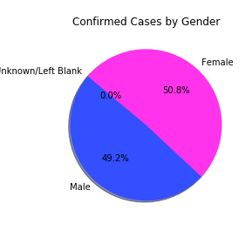
Do more males or females have confirmed Covid-19 cases?
It looks like both males and females are distributed evenly so no one gender is more likely to get infected
Conclusion: Be careful no matter what gender you are.

Slide 5
Is any one race more likely to catch Covid-19?
Seeing if any one race is more likely to get Covid can influence the best to approach fighting the disease and we can isolate why that race is more likely to get Covid and any underlying issues.

Slide 6
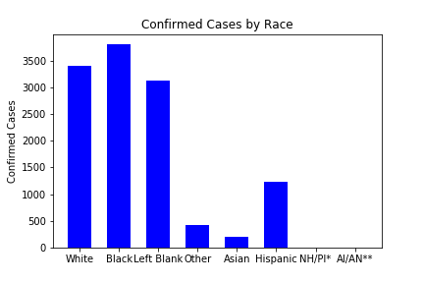
Is any one race more likely to catch Covid-19?
If we compare our total against race demographics in Illinois, Black represent a higher proportion of confirmed cases than their population
Conclusion: As we move forward with fighting the disease, we need to address this and the underlying cause of why this is occurring.

Slide 7
We’ve all heard the the disease is particular deadly for the elderly, are they more statistically likely to be Covid positive?
We’re all doing social distancing to a degree, if it is proven that only an age group is getting the disease. This can influence how society can move forward after the lockdown

Slide 8
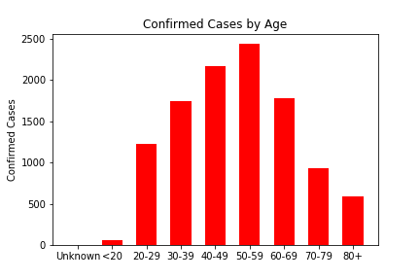
We’ve all heard the the disease is particular deadly for the elderly, are they more statistically likely to be Covid positive?
It looks like the age breakdown is skewed older with the highest confirmed cases in their 40’s and 50’s. What’s surprising is that confirmed cases younger than 20 is so low.
Conclusion: Older people need to be more careful. There is also a lot of news that there are a lot of asymptotic people. This could be the case why younger people have such a low number of confirmed cases.

Slide 9
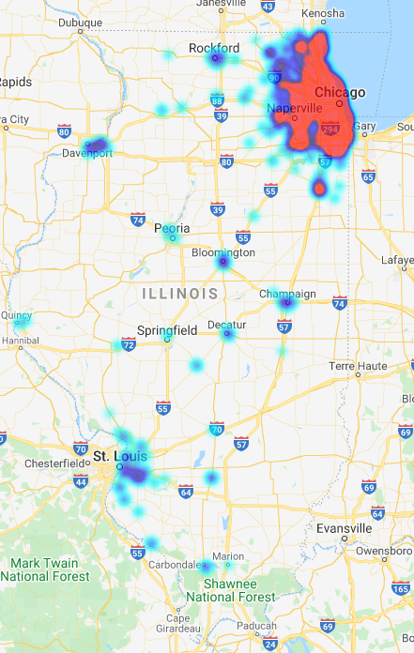
Cases across Illinois
We would assume that more cases of the virus would be found in densely populated areas of Illinois.
By making a heatmap of cases per zip code, we find that the most cases can be found in cities all over Illinois.

Slide 10
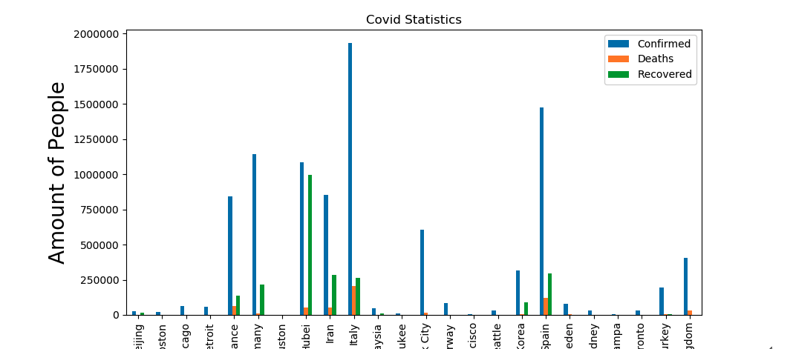
Major Countries/Provinces with Covid-19
This visualization shows what some big countries/provinces had with confirmed cases/recovery/death
As you can see, the more amount of cases was correlated with the higher amount of deaths.

Slide 11
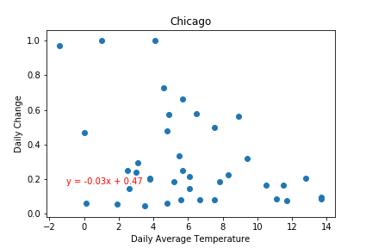
It has been claimed that the spread of the disease is slowed down as the temperature rises, is this true?
This scatterplot shows the average daily temperature vs daily change in active cases for Chicago, Illinois. (datapoints where daily change = 0 has been removed)
Linear regression analysis for this country shows a slight negative correlation between temperature and daily change in the number of active cases.

Slide 12
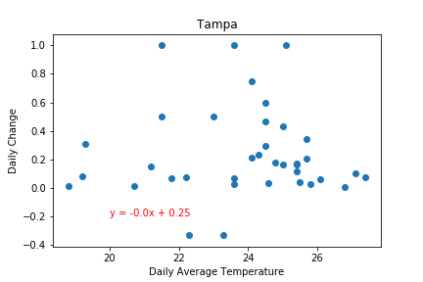
It has been claimed that the spread of the disease is slowed down as the temperature rises, is this true?
This scatterplot shows the average daily temperature vs daily change in active cases for Tampa, FL. (datapoints where daily change = 0 has been removed)
Linear regression analysis for this country shows a very very slight negative correlation between temperature and daily change in the number of active cases.

Slide 13
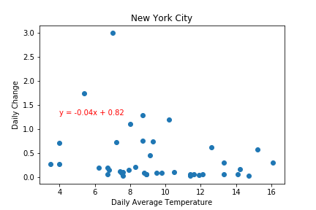
It has been claimed that the spread of the disease is slowed down as the temperature rises, is this true?
This scatterplot shows the average daily temperature vs daily change in active cases for New York, NY. (datapoints where daily change = 0 has been removed)
Linear regression analysis for this country shows a slight negative correlation between temperature and daily change in the number of active cases.

Slide 14
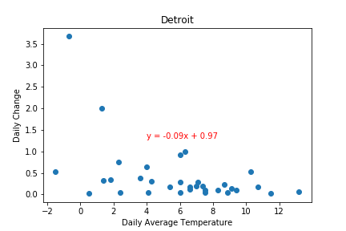
It has been claimed that the spread of the disease is slowed down as the temperature rises, is this true?
This scatterplot shows the average daily temperature vs daily change in active cases for Detroit, MI. (datapoints where daily change = 0 has been removed)
Linear regression analysis for this country shows a slight negative correlation between temperature and daily change in the number of active cases.

Slide 15
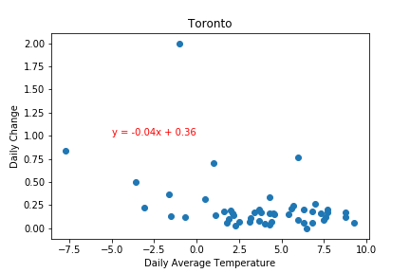
It has been claimed that the spread of the disease is slowed down as the temperature rises, is this true?
This scatterplot shows the average daily temperature vs daily change in active cases for Toronto, ON. (datapoints where daily change = 0 has been removed)
Linear regression analysis for this country shows a slight negative correlation between temperature and daily change in the number of active cases.

Slide 16
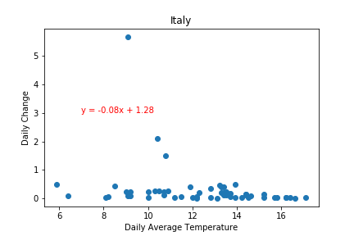
It has been claimed that the spread of the disease is slowed down as the temperature rises, is this true?
This scatterplot shows the average daily temperature vs daily change in active cases for Italy. (datapoints where daily change = 0 has been removed, temperature data was for Rome, Italy)
Linear regression analysis for this country shows a very very slight negative correlation between temperature and daily change in the number of active cases.

Slide 17
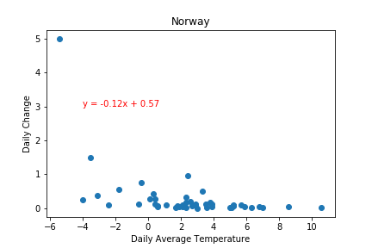
It has been claimed that the spread of the disease is slowed down as the temperature rises, is this true?
This scatterplot shows the average daily temperature vs daily change in active cases for Norway. (datapoints where daily change = 0 has been removed, temperature data was for Oslo, Norway)
Linear regression analysis for this country shows a negative correlation between temperature and daily change in the number of active cases.

Slide 18
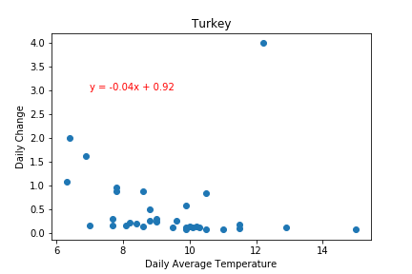
It has been claimed that the spread of the disease is slowed down as the temperature rises, is this true?
This scatterplot shows the average daily temperature vs daily change in active cases for Turkey. (datapoints where daily change = 0 has been removed, temperature data was for Istanbul, Turkey)
Linear regression analysis for this country shows a very slight negative correlation between temperature and daily change in the number of active cases.

Slide 19
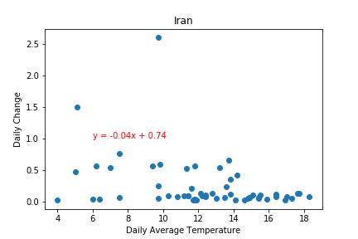
It has been claimed that the spread of the disease is slowed down as the temperature rises, is this true?
This scatterplot shows the average daily temperature vs daily change in active cases for Iran. (datapoints where daily change = 0 has been removed, temperature data was for Teheran, Iran)
Linear regression analysis for this country shows a slight negative correlation between temperature and daily change in the number of active cases.

Slide 20
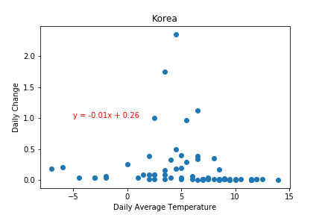
It has been claimed that the spread of the disease is slowed down as the temperature rises, is this true?
This scatterplot shows the average daily temperature vs daily change in active cases for South Korea. (datapoints where daily change = 0 has been removed, temperature data was for Seoul, Korea)
Linear regression analysis for this country shows a very very slight negative correlation between temperature and daily change in the number of active cases.

Slide 21
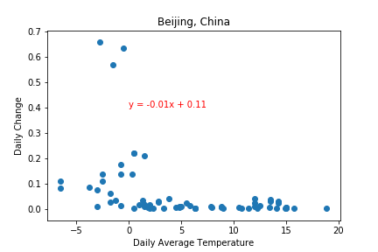
It has been claimed that the spread of the disease is slowed down as the temperature rises, is this true?
This scatterplot shows the average daily temperature vs daily change in active cases for Beijing, China. (datapoints where daily change = 0 has been removed)
Linear regression analysis for this country shows a very very slight negative correlation between temperature and daily change in the number of active cases.

Slide 22
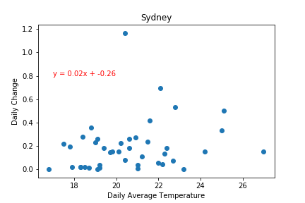
It has been claimed that the spread of the disease is slowed down as the temperature rises, is this true?
This scatterplot shows the average daily temperature vs daily change in active cases for Sydney Australia. (datapoints where daily change = 0 has been removed)
Linear regression analysis for this country shows a very very slight positive correlation between temperature and daily change in the number of active cases.

Slide 23
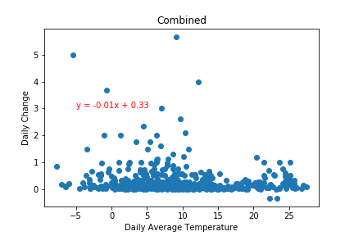
It has been claimed that the spread of the disease is slowed down as the temperature rises, is this true?
This scatterplot shows the average daily temperature vs daily change in active cases for all the aforementioned locations. (datapoints where daily change = 0 has been removed)
Linear regression analysis shows a very slight negative correlation between temperature and daily change in the number of active cases.
However, it’s important to note that the Openweatherapi does not provide historical temperature data to free users, so the dataset probably does not provide enough significance
Conclusion: It may be true, we would have to look at more data, read into the pricing document for api requests more carefully before you start your project.

